Slide 1
surfaceFilmModel extensions in an industrial setting
Johan Nilsson Gothenburg, Sweden
2017-11-15

Slide 2
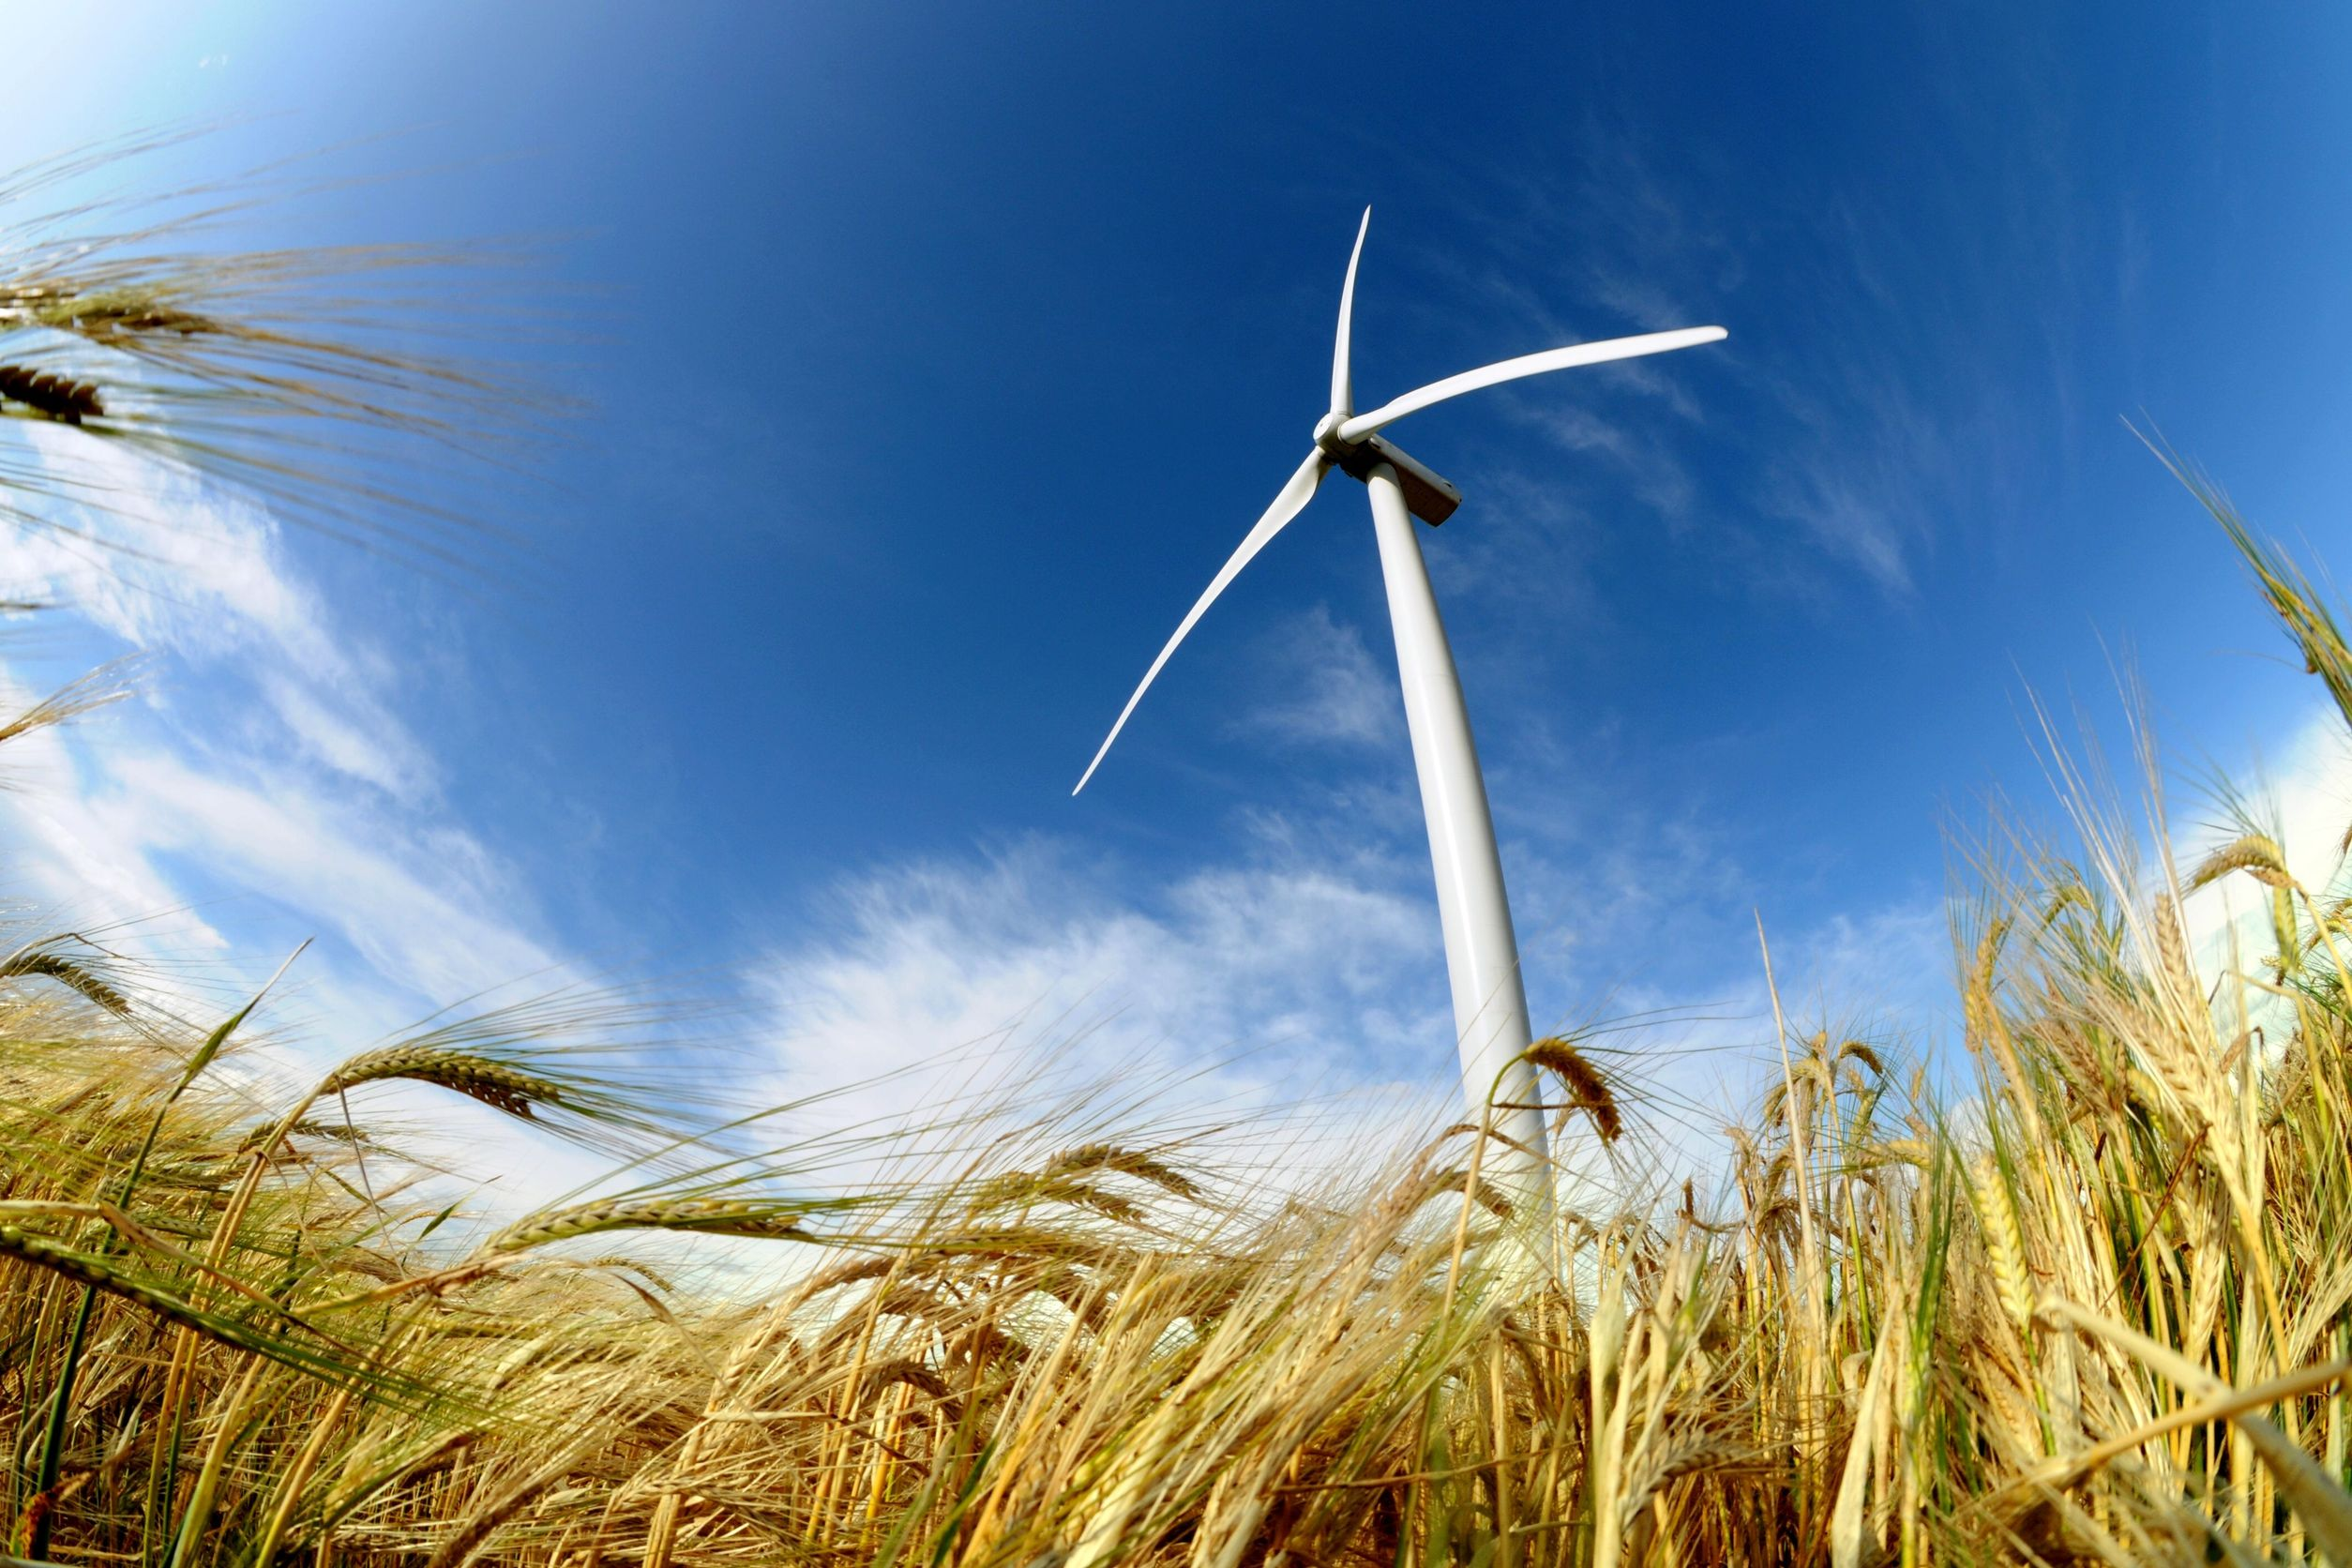
Creo Dynamics – A New Way of Working
Providing state-of-the-art specialist consulting services
Participation in 7 research projects (Sweden & EU)
Documented history of delivering innovation, giving customers a competitive edge
Research
Innovation
Consulting
The synergy between our three business areas helps us maintain state-of-the-art knowledge, so that we can provide our customers with the very best specialist technical services.

Slide 3
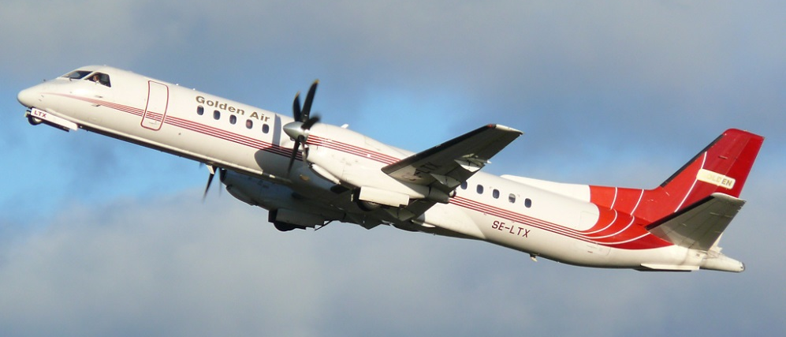
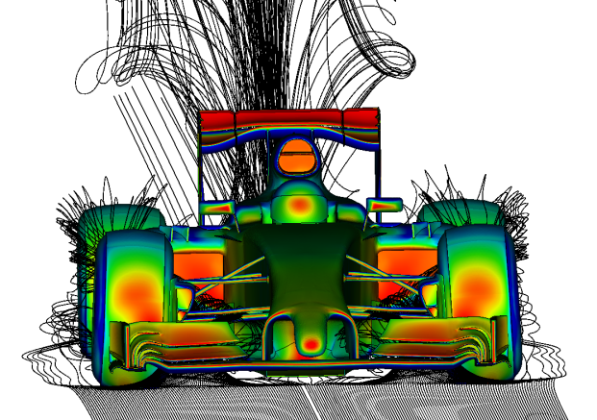
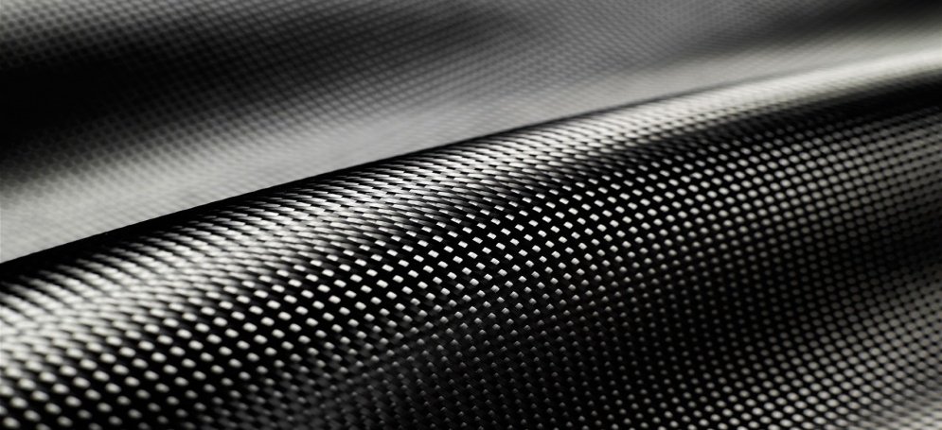
Creo Dynamics – Competence Areas
Pioneering in Active Noise Control systems for aerospace & automotive applications
Keep informative sound, attenuate irritating sound & amplify impressive sound
Acoustics
Solving flow problems using CFD or analytical methods
External flow, internal flow, heat transfer, combustion etc.
Open source CFD methodology, leveraging our Formula One experience for leading performance & cost efficiency
Fluid Mechanics / CFD
Building intelligence into composite structures
Health monitoring, load/temperature sensing, efficient NDT methods
Analysis & optimization of lightweight structures
Smart Structures

Slide 4
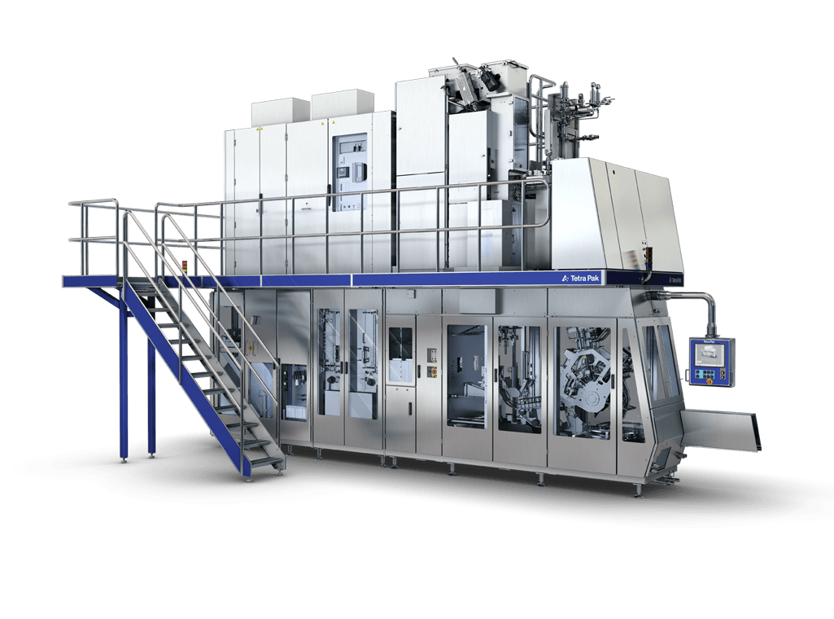
Problem description – Machine sterilisation using hydrogen peroxide
Tetra Pak filling machine sterilization, i.e. sterilization of the machine, not the product nor the package material
Gaseous hydrogen peroxide (H₂O₂) is used to kill bacteria
The hydrogen peroxide condensates inside the filling machine
At the end of the sterilization process, all hydrogen peroxide should be evaporated
Notes:
This project has been carried out for Tetra Pak. Tetra Pak is a large multinational food packaging company which has been particularly successful with its aseptic package systems. The idea with an aseptic package is that if you have a completely sterile process you can get a product with a long shelf time without the need of refrigeration. Obviously you need a sterile product and container, but it’s also important that the entire process including the filling machine itself is sterile.

Slide 5
Problem description – Machine sterilisation using hydrogen peroxide
Phase 0: Initial condition
Pipe – solid – cold
Air + H₂O₂ + H₂O – gas – hot
Flow

Slide 6
Problem description – Machine sterilisation using hydrogen peroxide
Phase 1: H₂O₂ and H₂O condensate on the pipe forming a liquid film
Pipe – solid – cold
Film – liquid – H₂O₂ + H₂O
Air + H₂O₂ + H₂O – gas – hot
Flow

Slide 7
Problem description – Machine sterilisation using hydrogen peroxide
Phase 2: Dry air is sent into the machine, no H₂O₂ and H₂O. The film begins to evaporate.
Pipe – solid – warm
Film – liquid – H₂O₂ + H₂O
Air – gas – hot
Flow

Slide 8
Problem description – Machine sterilisation using hydrogen peroxide
Phase 3: Since H₂O evaporates faster than H₂O₂, the H₂O₂ concentration increase in the film.
Pipe – solid – warmer
Film – liquid – H₂O₂ + H₂O
Air – gas – hot
Flow

Slide 9
Problem description – Machine sterilisation using hydrogen peroxide
Phase 4: The liquid film has evaporated completely
Pipe – solid – hot
Air – gas – hot
Flow

Slide 10
Challenges involved
A lot of physics going on:
Conjugate heat transfer simulation necessary for proper heat transfer
Surface film modelling needed
Film requirements
Two component
Phase change (evaporation and condensation)
Moving/flowing film
Heat transfer
Separation from stripping etc
Injection from droplets
Gas domain needs to be multi-component
Spray and droplets

Slide 11
Stock OpenFOAM capabilities – solvers
reactingParcelFilmFoam and chtMultiRegionFoam
reactingParcelFilmFoam
Uses surfaceFilmModel for surface film modelling
Multiple components in the gas domain
Spray and droplets
Lacks CHT (Conjugate Heat Transfer) coupling with other domains except for the film
chtMultiRegionFoam
Multi-region conjugate heat transfer coupling
Single component
No spray or droplets support
Solution: Add surfaceFilmModel, multi-components and spray/droplet support from reactingParcelFilmFoam into chtMultiRegionFoam to create chtMultiRegionFilmFoam

Slide 12
Stock OpenFOAM capabilities – surfaceFilmModel
Uses ”thin-film” assumptions
Wall-normal velocity is zero
Wall-tangential diffusion (momentum, energy) negligible compared to wall-normal diffusion
This means that the transport equations can be integrated in the wall-normal direction
Solves film continuity, momentum, energy and thickness equations
Lives in its own region (domain)
Mesh is extruded from gas or solid domain and is one cell thick
Film thickness is unrelated to the cell thickness in the film domain
fluid
film

Slide 13
Features that needed to be added or improved to the film library
Missing features that needed to be added
Two-component film
Features that needed improvement
Coupling to solid region
Gas to film momentum coupling
Heat transfer film-gas and film-solid
Phase change models

Slide 14
Two component film
Specie transport equation added
The thermodynamical properties are calculated using the built-in liquidMixtureProperties class
Density, saturation pressure, latent heat and specific heat capacity is computed as the mass fraction weighted average
The surface tension force is based on the surface mole fractions estimated from Raoult’s law
Thermal conductivity is estimated using Li’s method
The vapour diffusivity is calculated using Blanc’s law

Slide 15
Heat transfer
CHT type heat transfer needed
Exisiting connectivity between film and gas regions
Added film and solid region connectivity
gas
film
solid

Slide 16
Heat transfer – stock OpenFOAM
$q_{solid}=h_{solid}\left(T_{solid}−T_{film}\right), q_{gas}=h_{gas}\left(T_{gas}−T_{film}\right)$
$h$ is the heat transfer coefficient
The above enters as a source term into the film heat equation
Two models exists for $h$, constant and mapped.
constantHeatTransfer – $h$ is a specified constant over the entire patch
mappedConvectiveHeatTransfer – $h$ is mapped from a field that is registred to the gas domain. There it is computed based on a Nusselt number correlation:
$κ$ is the thermal conductivity of the film liquid
$L$ is a user specified characteristic length
$$h=\left\{\begin{aligned}\frac{0.037 Re^{4/5}Pr^{1/3}κ}{L}, Re<500 000 \\ &\frac{0.664 Re^{1/2}Pr^{1/3}κ}{L}, Re>500 000\end{aligned}\right.$$

Slide 17
Heat transfer – present work
Use local heat balances instead of global!
Begin from the Fourier’s law $Q=−κ∇T$
This gives
$δ$ is the film thickness
A new temperature BC for use in gas, film and solid domains is also implemented
Existing turbulentTemperatureCoupledBaffleMixed is extended so that it handles that some part of the film domain are covered in a liquid film and some are dry
$$q_{solid}=\frac{κ}{C_{p}δ/2}\left(T_{film}−T_{solid}\right), q_{gas}=\frac{κ}{C_{p}δ/2}(T_{film}−T_{gas})$$

Slide 18
Two component phase change
Stock OpenFOAM surfaceFilmModel only supports evaporation and boiling
The stock evaporation model is based on a Sherwood number relation that is analogous to the Nusselt number relation for the heat transfer coefficient
The stock evaporation model requires a characteristic length $L$ to be specified
In the present work we implement Raoult’s law that is based on partial pressures
Basically, evaporation or condensation takes place if the specie concentration immediately above the film is higher or lower than in the nearest gas cell center.

Slide 19
Momentum coupling
Stock OpenFOAM uses a simplified model for the momentum coupling
The shear stress in the film on the surface against the gas domain is stock OpenFOAM: $τ=C_{f}ρ_{gas}\left|U_{gas}−U_{film}\right|$
$C_{f}$ is a user specified friction coefficient
In the present work we instead use that the shear stress should be equal on both sides of the film-gas interface
Once again, base the implementation on local balances instead of global coefficients

Slide 20
Simulations
Only parts of the supply system is simulated in this work – the end goal was to simulate a much larger part of the machine
URANS simulation
Mesh size is 770 kCells
Simulated time is 42 s
Animation

Slide 21
Concluding remarks
The stock surfaceFilmModel has been extended and improved to suit the needs of Tetra Pak
A new solver, chtMultiRegionFilmFoam has been created for use with the new film model

Slide 22
Stock OpenFOAM capabilities – Exisiting features
Contact angle forces
Thermocapillary forces
Radiation support
Curvature separation
Dripping injection
Impingement
Capillary pressure
Gas-phase pressure
Gravity force

