Slide 1
Turbine performance:
comparison between CFD and measurements.
Björn Bergqvist -Minesto
Project start date 2016-01-01
Duration 30 months
Budget 5 074 k€
Grant Agreement number 654438
This project has received funding from the European Union’s Horizon 2020 research and innovation programme under grant agreement No 654438. Disclaimer: The content of this presentation reflects only the author’s view and the Agency is not responsible for any use that may be made of the information it contains.

Slide 2
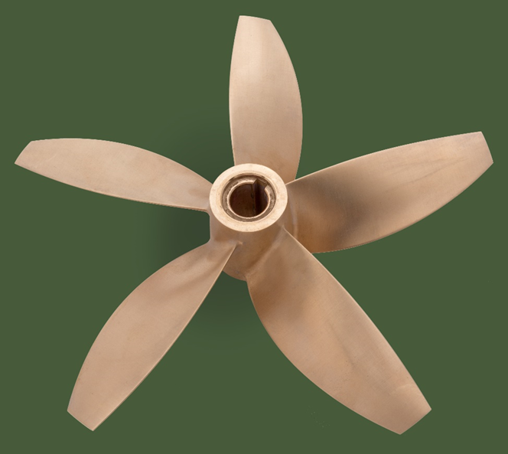
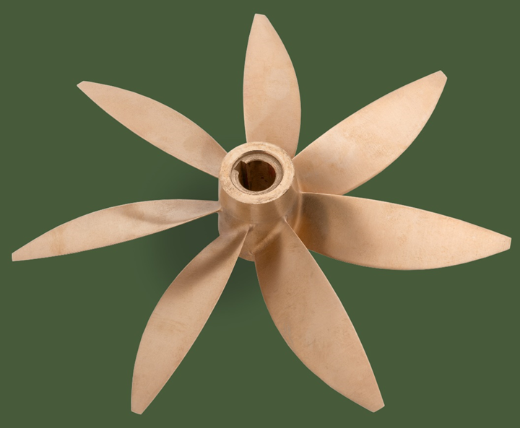
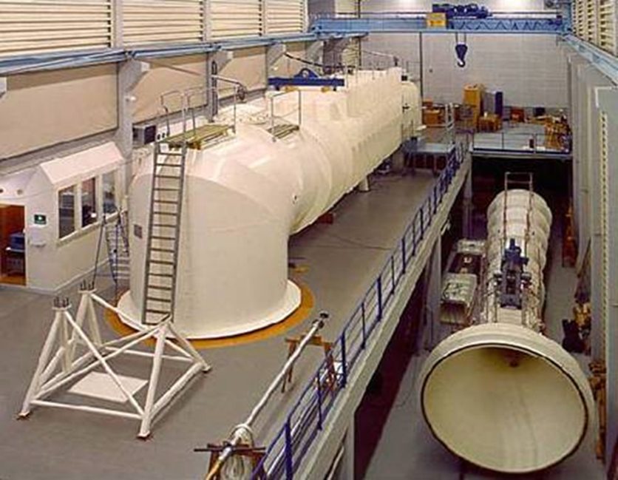
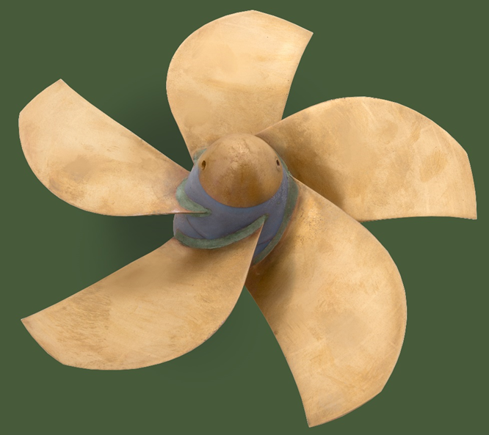
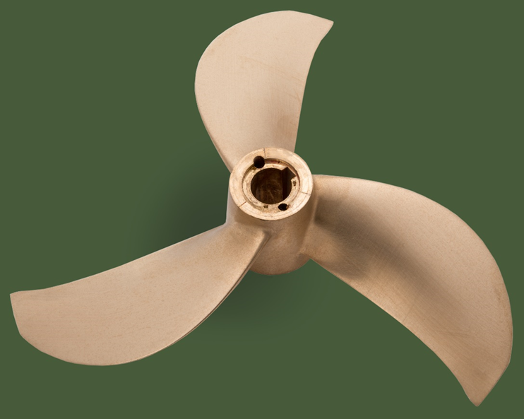
What has been done?
Within Powerkite project turbines has been developed and tested
Optimization made by SSPA and Minesto independently of each other
Four different designs tested in SSPA cavitation tunnel

Slide 3
How accurate can we simulate?
Simulate performance for the design Tip Speed Ratio has shown excellent agreement with test
The characteristics of the performance for many tip speed ratios seems to differ
What influence this?
Turbulence model?
Boundary layer ambition?
Inflow turbulence magnitude?

Slide 4
I‘ve tested this
MRF steady state
realizableKE
kOmegaSST
RSM

Slide 5
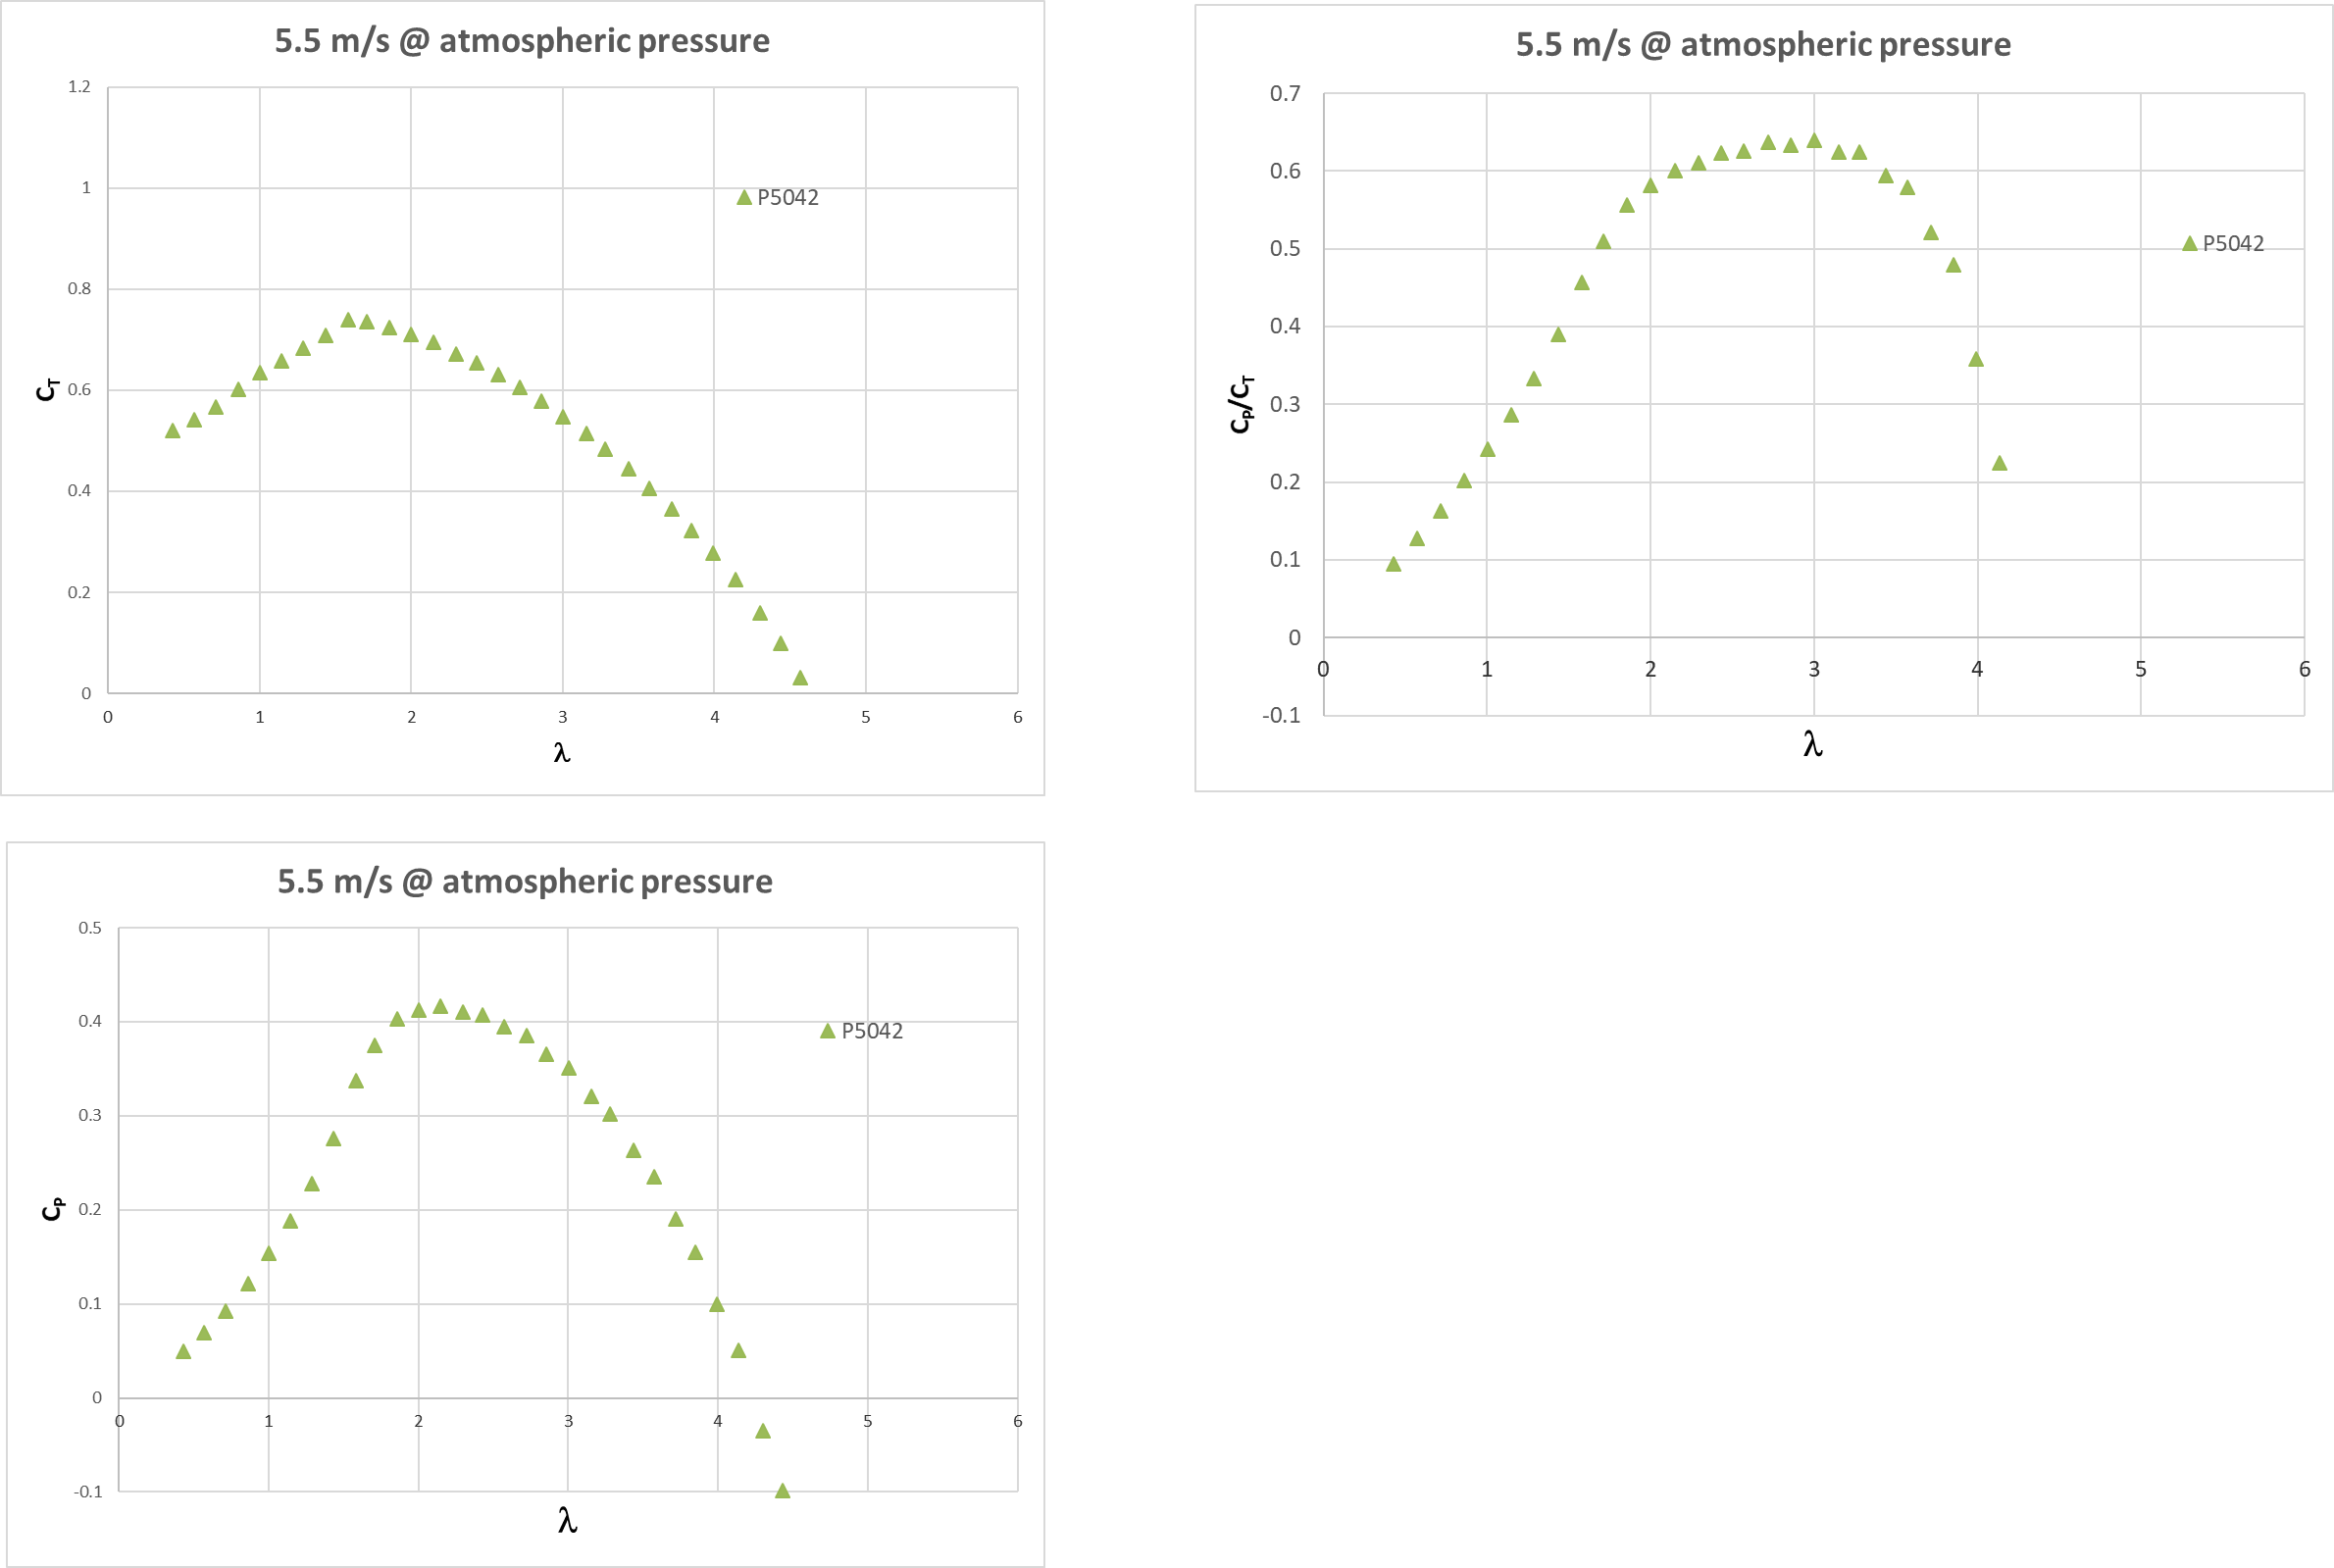
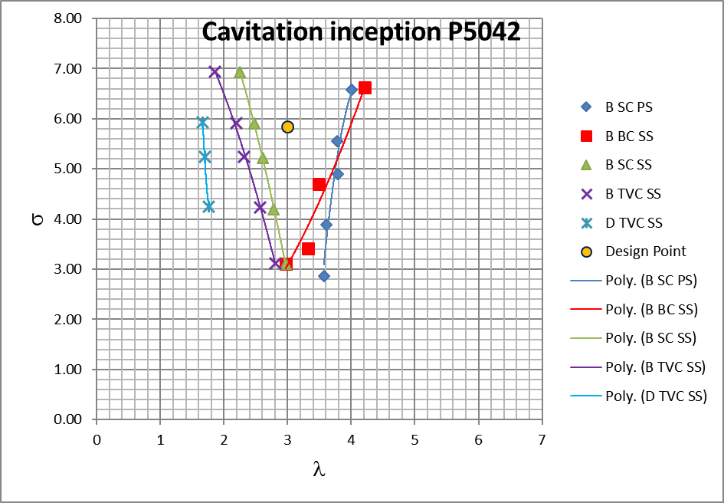
Results

Slide 6
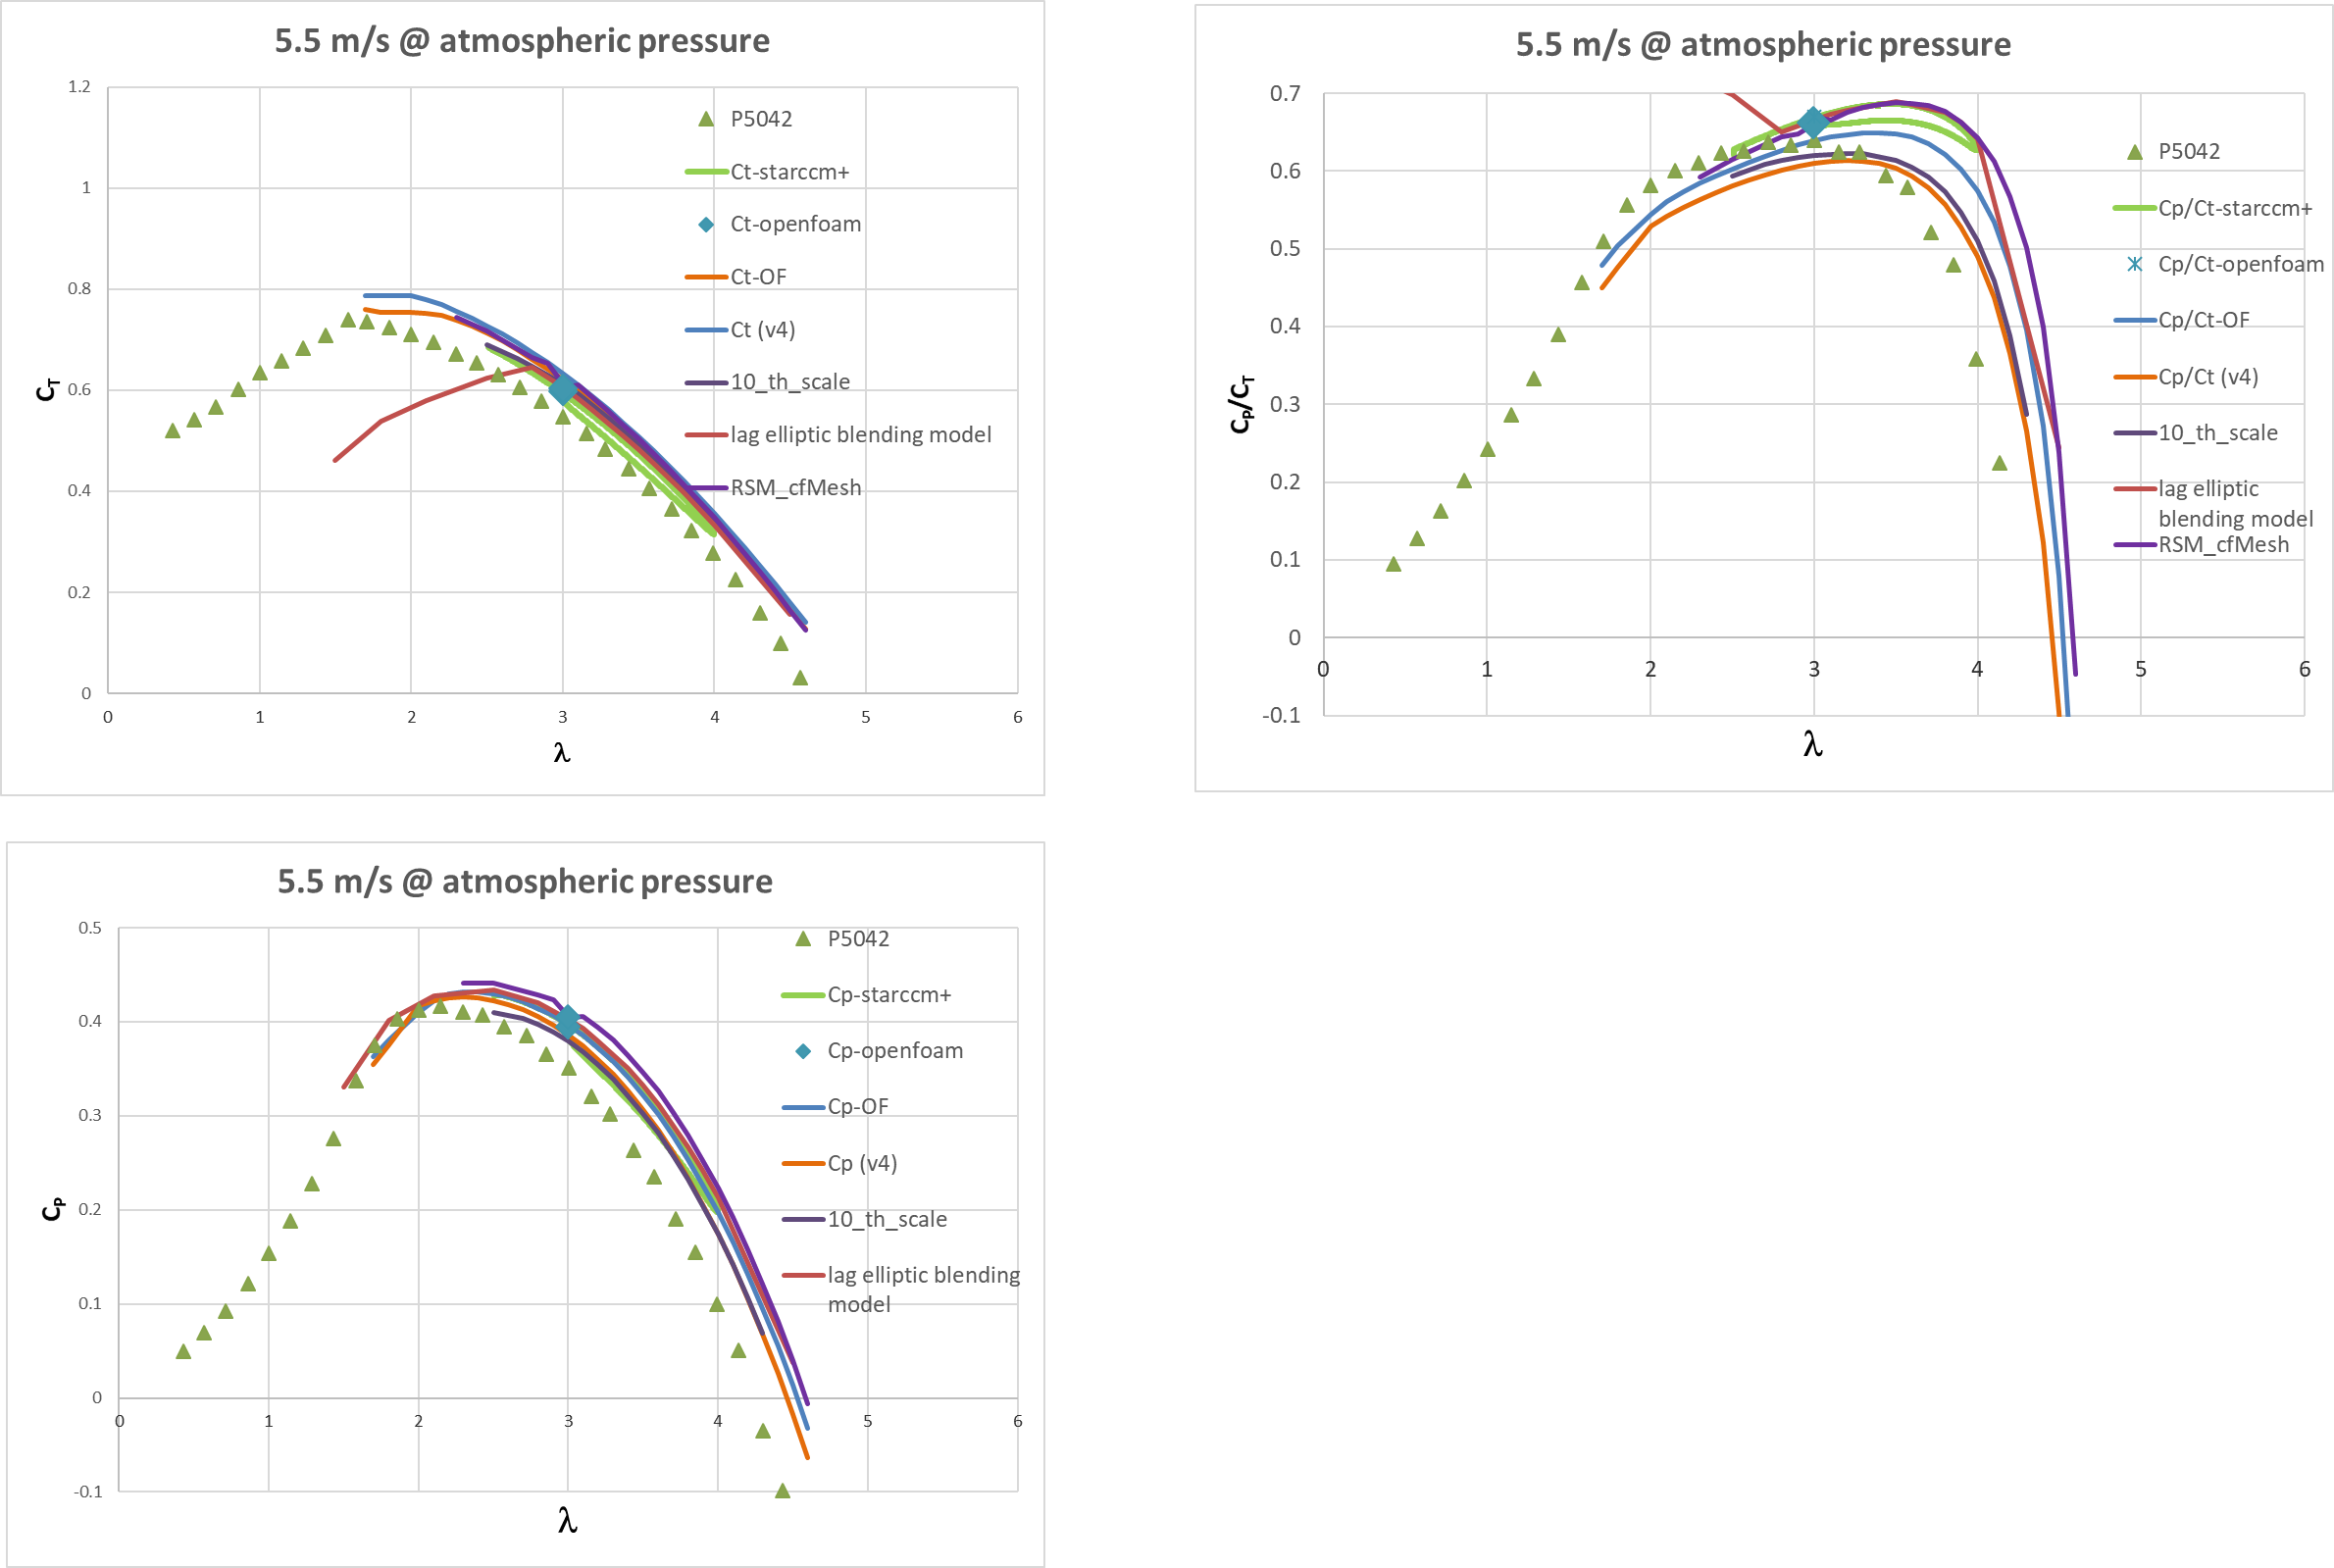
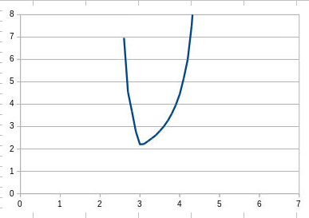
Results

Slide 7
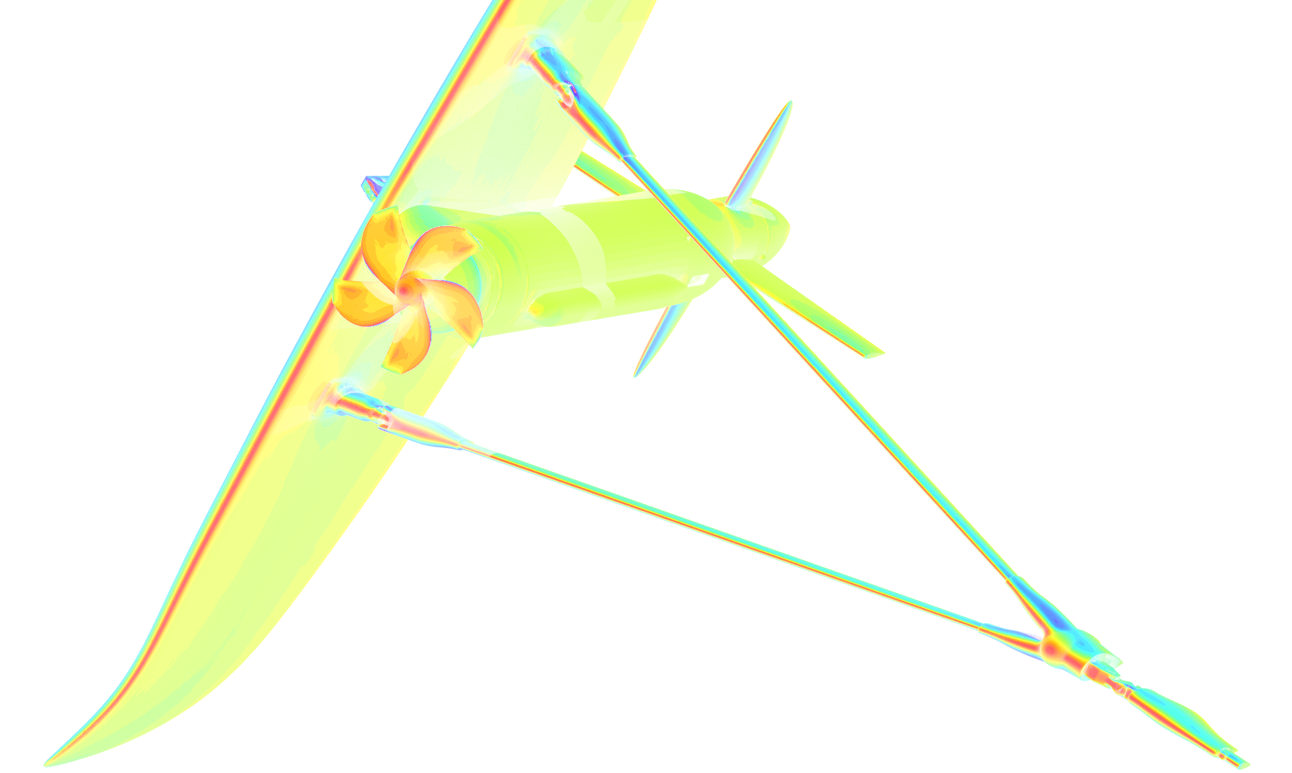
Power to change the future

