Slide 1
FSI for Assessing Nerve Injury During Whiplash Motion
Hua-Dong Yao, Håkan Nilsson, Mats Svensson
Department of Applied Mechanics,
Chalmers University of Technology, Sweden
2013-11-13

Slide 2
List
Background
Methodology
Computational Settings
Results
Summary

Slide 3
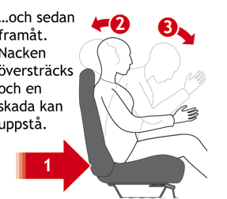
Introduction to Whiplash
The injuries happen in rear-end car crashes.
Damage at
  Intervertebral joints,
  Vertebral discs,
  Ligaments,
  Cervical muscles
  Nerve roots.
Our concern

Slide 4
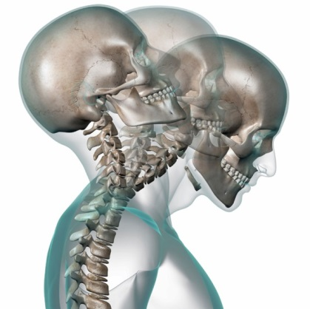
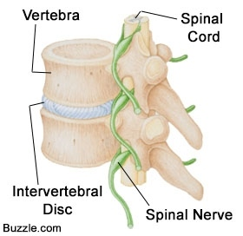
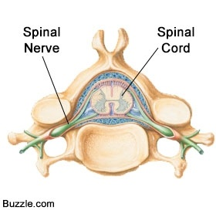
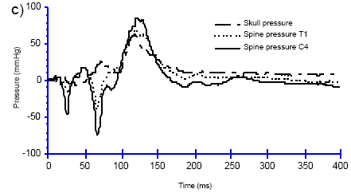
Nerve Injury during Whiplash Motion
Damage occurs at ganglion of spinal nerve.
Highly impulsive pressure is observed in venous plexus embedded in spinal canal.
Ganglion damage is possibly relative to this impulsive pressure.
Venous plexus
Ganglion
Giancarlo Canavese and Mats Svensson, Chalmers, 2004

Slide 5
FSI solver of OpenFOAM
The system is solved using the strongly coupled partitioned method.
Giancarlo Canavese and Mats Svensson, Chalmers, 2004

Slide 6
Strongly Coupled Partitioned Method
Step i-1
Solve mesh
Interface velocity
No
Solve flow
Check Residual
Interface load
Solve structure
Yes
Interface deformation
Step i

Slide 7
Acceleration Scheme
The Aitken relaxation applies to accelerate iterations.

Slide 8
Fluid and Structure Solvers
Fluid is incompressible.
Fluid solver utilizes the PISO algorithm.
Structure has linear elasticity.
Structure solver employs the discretization of a second-order finite volume method in space and a second-order backward method in time.
Governing equation of structure
Discretization in space
Discretization in time

Slide 9
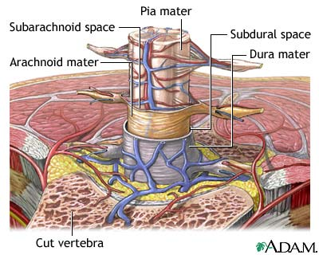
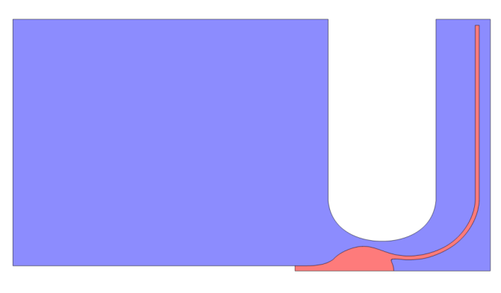
Simplified Geometry
Computational geometry is simplified
based on the human anatomy.
The geometry is two-dimensional.
31.3 mm
5.4 mm
3.9 mm
Dura mater
Fluid part
24.5 mm
Solid part
Ganglion

Slide 10
Mesh Generation
The mesh is unstructured.
ICEM is used for mesh generation.
Height of the first layer of the fluid mesh is 0.01 mm.

Slide 11
Boundary Conditions
1D modeling with Simulink
pressure: fixedValue
velocity: zeroGradient
pressure: timeVaryingUniformFixedValue
velocity: zeroGradient
wall
wall
wall
symmetryPlane

Slide 12
Computation Condition
Parallel computation with four processors.
Decomposition of the computational domain adopts the method of ‘simple’.
Time interval – Δt -- is 5e-6 sec.
Simulated physical period is 0.2 sec.
Wall-clock time is approximately 36 sec per step.
Pressure at the inlet

Slide 13
Results
Movie

Slide 14
Results
Deformation of the ganglion is associated with pressure variation.
Pressure at the inlet

Slide 15
Summary
The FSI solver of OpenFOAM succeeds in predicting the nerve injury of whiplash.
The computation is paralleled.
The ganglion deformation is connected with the pressure impulsion of venous plexus, which is reproduced by imposing a varying pressure boundary condition at the inlet.
We will extend the present 2D simulation to 3D.

Slide 16
Thanks!

Slide 17
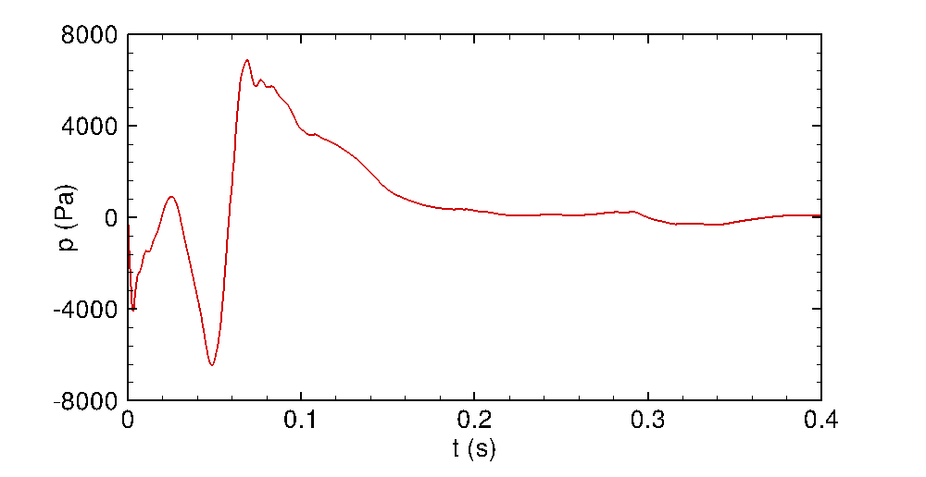
Results
Experiment
Modelling by Simulink
FSI by OpenFOAM
Giancarlo Canavese and Mats Svensson, Chalmers, 2004

Slide 18
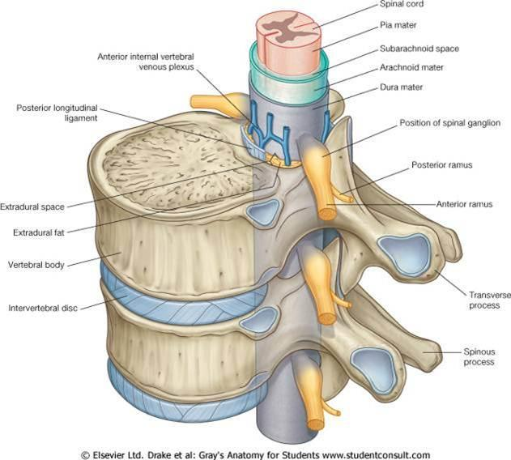
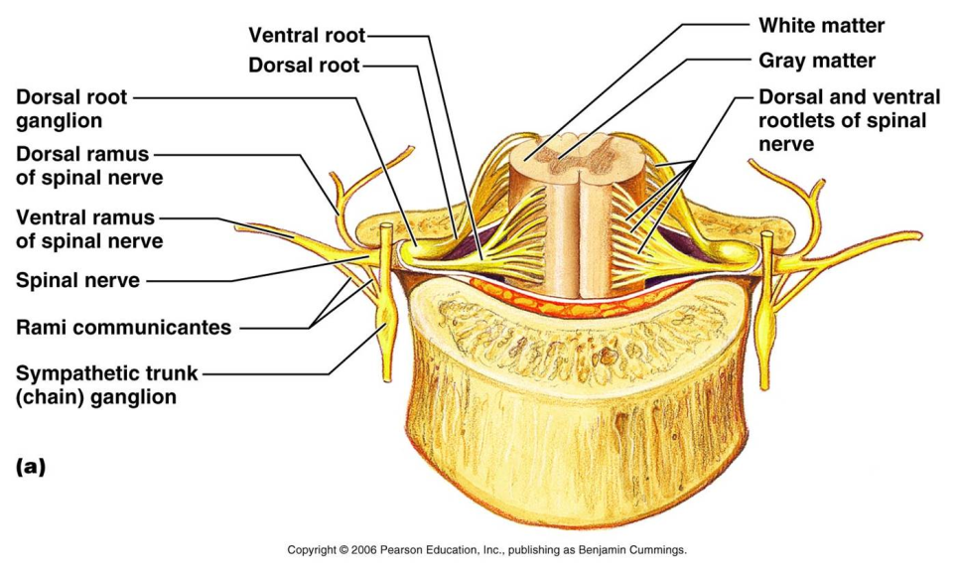
Computation Setting -- Simplified Geometry
The injury

