Slide 1


A global partner in engineering services and product information
Notes:
WHERE!
23 sites in Sweden, 8 sites in Germany, 5 sites in UK, 2 sites in Brazil
Our strategy is to be near our customers and we follow them.

Slide 2
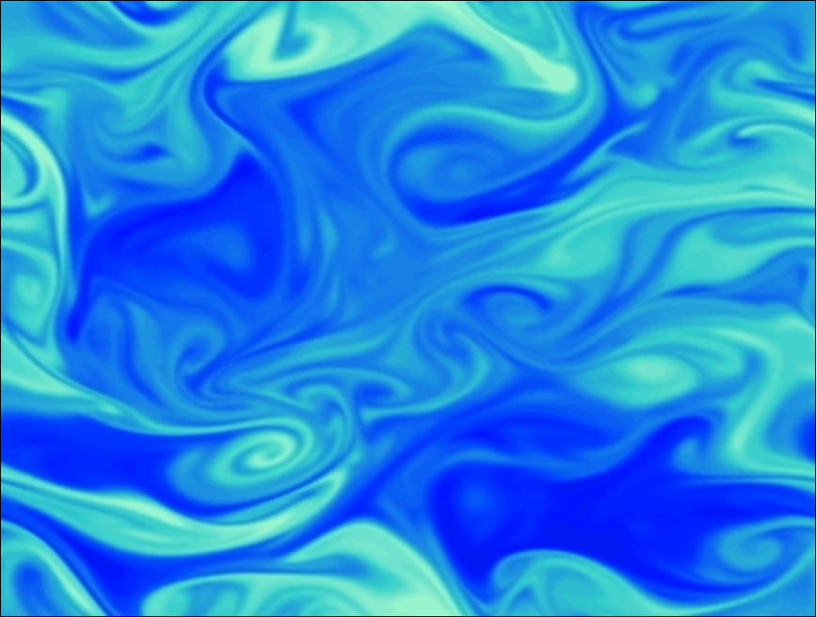
Advancement in RANS modelling of turbulent dispersion
Federico Ghirelli
Gothenburg region OpenFOAM user group meeting
November 13, 2013

Slide 3
SIMPLEST POSSIBLE EXPERIMENT:
Point source in steady homogeneous turbulence
The fluid in position X0 is marked with a tracer at time t0.
Several realizations give the average tracer concentration field (or pdf of particle position).
The dispersion of the tracer is characterised by the standard deviation σ(t) of the concentration.

Slide 4

Turbulent diffusion coefficient for the point source in steady homogeneous turbulence
It is widely accepted that in this experiment dispersion can be modelled as diffusion with diffusion coefficient:
Effect of correlation (often neglected)
Dotted and dashed curves: default RANS models in CFD codes

Slide 5
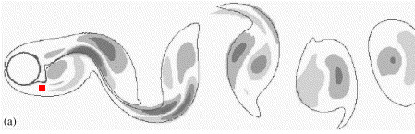
Time scale of the vortex shedding behind a cylinder
source

Slide 6
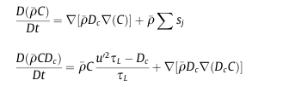
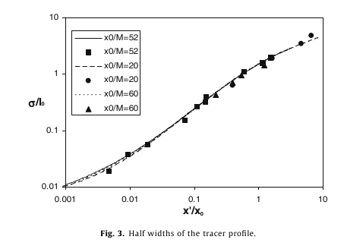
Two-equations approach
Point source in homogeneous turbulence or plume in homogeneous turbulence
Plume in decaying turbulence

Slide 7
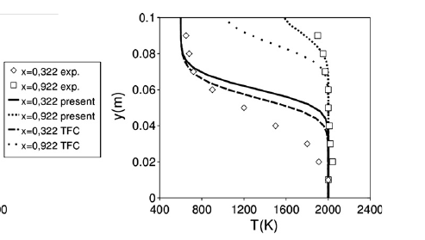
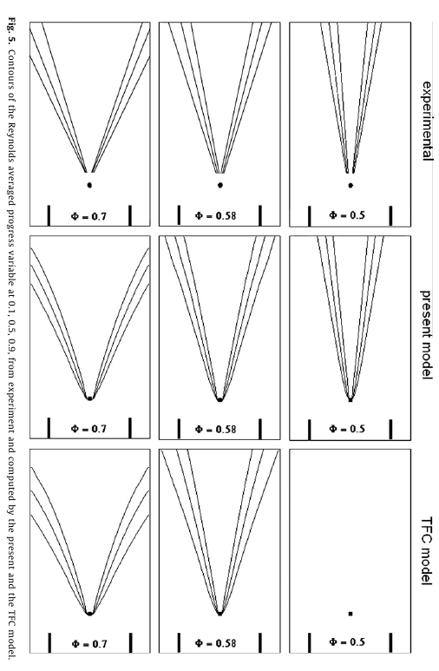
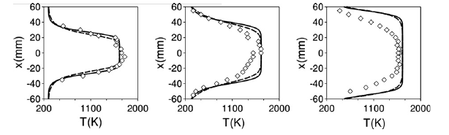
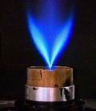
My model of premixed flame, validation and comparison
Moreau burner: flame stabilized by a pilot flame
Volvo test: bluff body stabilized flame
V-flame:
Stabilized by a wire

Slide 8
Multiple point sources
  Relevant because using many point sources it is possible to represent arbitrary sources
  The two-equations approach loses accuracy when non-simultaneous sources are placed near each other
  The most critical case is the ”unsteady plume in zero mean velocity”

Slide 9
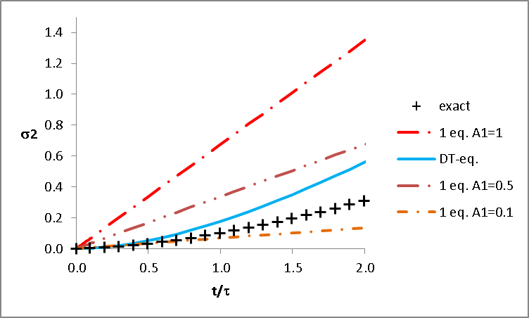
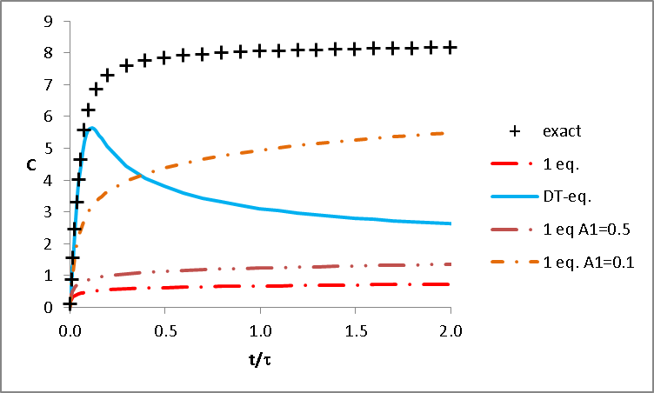
The unsteady plume in zero mean velocity:
A point source that is zero before a given time t₀ and constant afterwards. The flow has zero mean velocity and homogeneous steady turbulence.
This case is critical because diffusion occurs simultaneously at several regimes at the same position.

Slide 10
New approach
  Using a single diffusion coefficient seems inadequate for modelling dispersion when dispersion occurs at several regimes simultaneously.
  New approach: dispersion is modelled as a discrete number of processes each of which is solved by means of a transport equation.
  The model will be referred to as DEMD (discrete
  Eulerian model of dispersion)

Slide 11
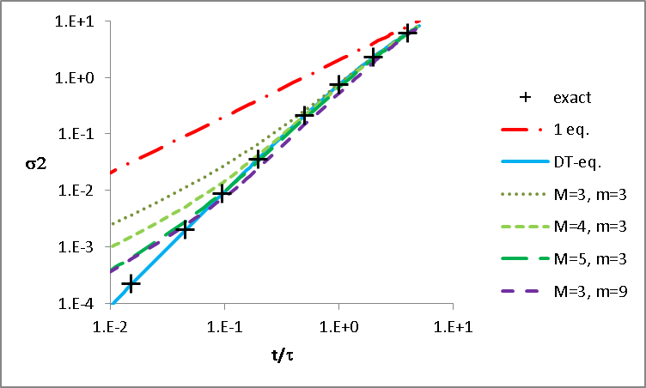
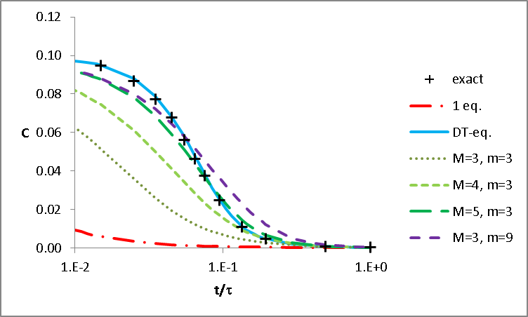
Results: single point source
The two-equation model is the most accurate for modelling dispersion from a single point source
The accuracy of the DEMD model increases with finer discretization

Slide 12
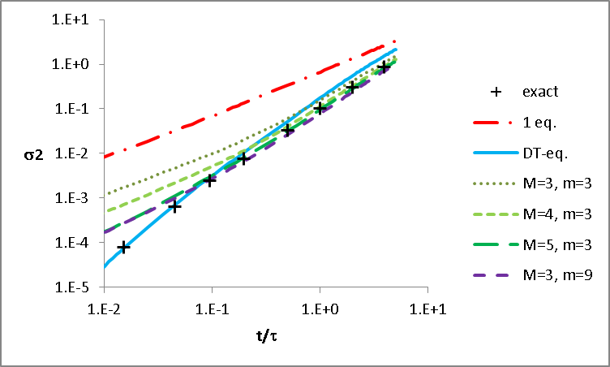
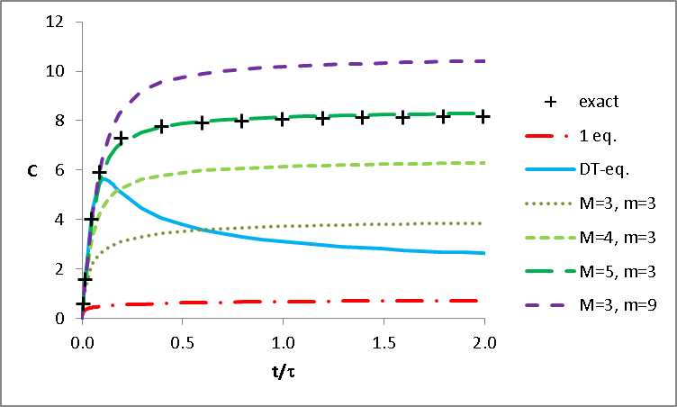
Results: unsteady plume
The DEMD model does not produce the qualitative error as the two-equations model does.

Slide 13
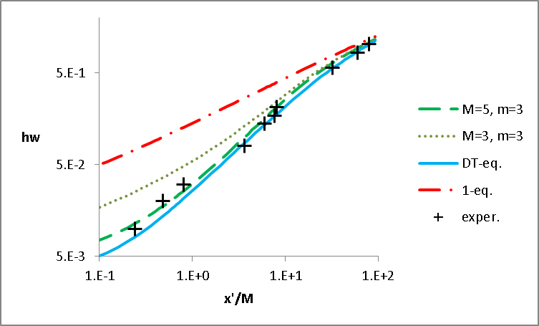
Results: single point source in decaying turbulence
.
Compared to experimental results of Warhaft
WARHAFT Z. 1984 The interference of thermal fields from line sources in grid turbulence. J. Fluid Mech. 144, 363–87

Slide 14
Discussion
Dispersion is highly relevant for the transport of:
momentum
mass
turbulence
heat
The accuracy of the DEMD model cannot exceed the accuracy of its input parameters
(i.e u’ and τ).

Slide 15
Conclusion
Accounting for the ”effect of correlation” leads to significant improvements in dispersion modelling.
The DEMD approach predicts dispersion correctly in the case of multiple sources (i.e. generic sources).

